Slide 1

Sort and
Merge

Slide 2
DATA DIVISION.
FILE SECTION.
FD StudentFile.
01 StudentDetails.
02 StudentId PIC 9(7).
02 StudentName.
03 Surname PIC X(8).
03 Initials PIC XX.
02 DateOfBirth.
03 YOBirth PIC 9(2).
03 MOBirth PIC 9(2).
03 DOBirth PIC 9(2).
02 CourseCode PIC X(4).
02 Grant PIC 9(4).
02 Gender PIC X.
The StudentFile is a sequential file sequenced upon ascending StudentId.
Write a program to display the number of students taking each course. How?

Slide 3
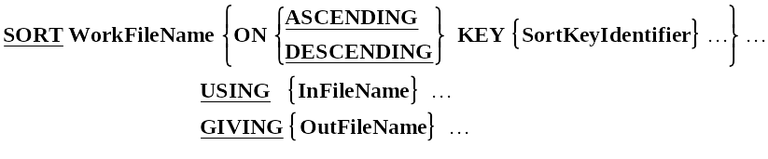
Simplified Sort Syntax.
The WorkFileName identifies a temporary work file that the SORT process uses for the sort. It is defined in the FILE SECTION using an SD entry.
Each SortKeyIdentifier identifies a field in the record of the work file upon which the file will be sequenced.
When more than one SortKeyIdentifier is specified, the keys decrease in significance from left to right (leftmost key is most significant, rightmost is least significant).
InFileName and OutFileName, are the names of the input and output files. These files are automatically opened by the SORT. When the SORT executes they must not be already open.
Notes:
The SDFilename is a temporary file described in an SD entry in the FILE SECTION.
The SortKeyIdentifier is a data item described in the SDFileName record.

Slide 4
Sort Example.
FD SalesFile.
01 SalesRec.
02 FILLER PIC X(10).
SD WorkFile.
01 WorkRec.
02 WSalesmanNum PIC 9(5).
02 FILLER PIC X(5).
FD SortedSalesFile.
01 SortedSalesRec.
02 SalesmanNum PIC 9(5).
02 ItemType PIC X.
02 QtySold PIC 9(4).
PROCEDURE DIVISION.
Begin.
SORT WorkFile ON ASCENDING KEY WSalesmanNum
USING SalesFile
GIVING SortedSalesFile.
OPEN INPUT SortedSalesFile.

Slide 5
ENVIRONMENT DIVISION.
INPUT-OUTPUT SECTION.
FILE-CONTROL.
SELECT WorkFile ASSIGN TO "WORK.TMP".
SD WorkFile.
01 WorkRecord.
02 ProvinceCode PIC 9.
02 SalesmanCode PIC 9(5).
02 FILLER PIC X(19).
PROCEDURE DIVISION.
Begin.
SORT WorkFile ON ASCENDING KEY ProvinceCode
DESCENDING KEY SalesmanCode
USING UnsortedSales
GIVING SortedSales.
OPEN INPUT SortedSales.

Slide 6
How the SORT works.
SalesFile
SortedSalesFile
Unsorted
Records
Sorted
Records
SORT
Process
WorkFile
SORT WorkFile ON ASCENDING KEY WSalesmanNum
USING SalesFile
GIVING SortedSalesFile.

Slide 7
How the INPUT PROCEDURE works.
SalesFile
SortedSalesFile
Unsorted
Records
Sorted
Records
Unsorted
Hat
Records
SORT
Process
SelectHatSales
WorkFile
SORT WorkFile ON ASCENDING KEY WSalesmanNum
INPUT PROCEDURE IS SelectHatSales
GIVING SortedSalesFile.

Slide 8
INPUT PROCEDURE Template
OPEN INPUT InFileName
READ InFileName RECORD
PERFORM UNTIL Condition
RELEASE SDWorkRec
READ InFileName RECORD
END-PERFORM
CLOSE InFile

Slide 9
INPUT PROCEDURE - Example
FD SalesFile.
01 SalesRec.
88 EndOfSales VALUE HIGH-VALUES.
02 FILLER PIC 9(5).
02 FILLER PIC X.
88 HatRecord VALUE "H".
02 FILLER PIC X(4).
SD WorkFile.
01 WorkRec.
02 WSalesmanNum PIC 9(5).
02 FILLER PIC X(5).
FD SortedSalesFile.
01 SortedSalesRec.
02 SalesmanNum PIC 9(5).
02 ItemType PIC X.
02 QtySold PIC 9(4).
PROCEDURE DIVISION.
Begin.
SORT WorkFile ON ASCENDING KEY WSalesmanNum
INPUT PROCEDURE IS SelectHatSales
GIVING SortedSalesFile.

Slide 10
New Version
SelectHatSales.
OPEN INPUT SalesFile
READ SalesFile
AT END SET EndOfSales TO TRUE
END-READ
PERFORM UNTIL EndOfSales
IF HatRecord
RELEASE WorkRec FROM SalesRec
END-IF
READ SalesFile
AT END SET EndOfSales TO TRUE
END-READ
END-PERFORM
CLOSE SalesFile.

Slide 11
Old Version
SelectHatSales SECTION.
BeginHatSales.
OPEN INPUT SalesFile
READ SalesFile
AT END SET EndOfSales TO TRUE
END-READ
PERFORM GetHatSales UNTIL EndOfSales
CLOSE SalesFile
GO TO SelectHatSalesExit.
GetHatSales.
IF HatRecord
RELEASE WorkRec FROM SalesRec
END-IF
READ SalesFile
AT END SET EndOfSales TO TRUE
END-READ.
SelectHatSalesExit
EXIT.

Slide 12
ENVIRONMENT DIVISION.
INPUT-OUTPUT SECTION.
FILE-CONTROL.
SELECT WorkFile ASSIGN TO "WORK.TMP".
SD WorkFile.
01 WorkRecord.
88 EndOfWorkFile VALUE HIGH-VALUES.
02 ProvinceCode PIC 9.
88 ProvinceIsUlster VALUE 4.
02 SalesmanCode PIC 9(5).
02 FILLER PIC X(19).
FD UnsortedSales.
01 FILLER PIC X(25).
FD SortedSales.
01 SortedRec.
88 EndOfSalesFile VALUE HIGH-VALUES.
02 ProvinceCode PIC 9.
02 SalesmanCode PIC 9(5).
02 ItemCode PIC 9(7).
02 ItemCost PIC 9(3)V99.
02 QtySold PIC 9(7).

Slide 13
PROCEDURE DIVISION.
Begin.
SORT WorkFile
ON ASCENDING KEY ProvinceCode
SalesmanCode
INPUT PROCEDURE IS SelectUlsterRecs
GIVING SortedSales.
OPEN INPUT SortedSales.
SelectUlsterRecs.
OPEN INPUT UnsortedSales
READ UnsortedSales INTO WorkRec
AT END SET EndOfSalesFile TO TRUE
END-READ
PERFORM UNTIL EndOfSalesFile
IF ProvinceIsUlster RELEASE WorkRec
END-IF
READ UnsortedSales INTO WorkRec
AT END SET EndOfSalesFile TO TRUE
END-READ
END-PERFORM
CLOSE UnsortedSales

Slide 14
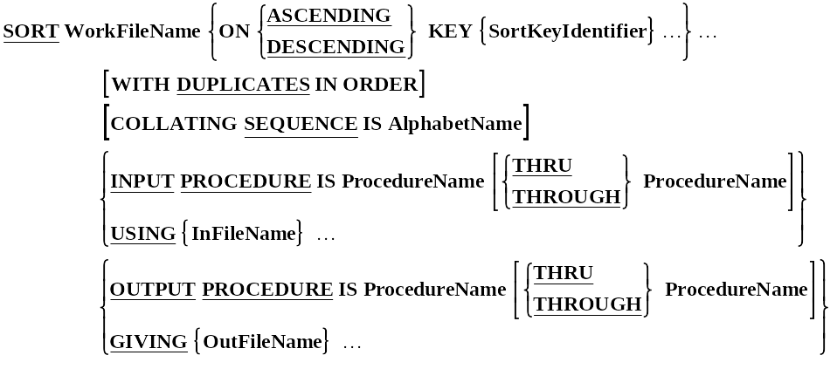
Full Sort Syntax.
ProcedureName is the name of a section or paragraph.
Notes:
The SDFilename is a temporary file described in an SD entry in the FILE SECTION.
The SortKeyIdentifier is a data item described in the SDFileName record.

Slide 15
How the OUTPUT PROCEDURE works.
SalesFile
SalesSummaryFile
Unsorted
Records
Salesman
Summary
Record
SORT
Process
Sorted
Records
SummariseSales
WorkFile
SORT WorkFile ON ASCENDING KEY WSalesmanNum
USING SalesFile
OUTPUT PROCEDURE IS SummariseSales.

Slide 16
OUTPUT PROCEDURE Template
OPEN OUTPUT OutFile
RETURN SDWorkFile RECORD
PERFORM UNTIL Condition
WRITE OutRec
RETURN SDWorkFile RECORD
END-PERFORM
CLOSE OutFile

Slide 17
Output PROCEDURE - Example
FD SalesFile.
01 SalesRec PIC X(10).
SD WorkFile.
01 WorkRec.
88 EndOfWorkFile VALUE HIGH-VALUES.
02 WSalesmanNum PIC 9(5).
02 FILLER PIC X.
02 WQtySold PIC X(4).
FD SalesSummaryFile.
01 SummaryRec.
02 SalesmanNum PIC 9(5).
02 TotalQtySold PIC 9(6).
PROCEDURE DIVISION.
Begin.
SORT WorkFile ON ASCENDING KEY WSalesmanNum
USING SalesFile
OUTPUT PROCEDURE IS SummariseSales.
OPEN INPUT SalesSummaryFile.
PERFORM PrintSummaryReport.

Slide 18
SummariseSales.
OPEN OUTPUT SalesSummaryFile
RETURN WorkFile
AT END SET EndOfWorkFile TO TRUE
END-RETURN
PERFORM UNTIL EndOfWorkFile
MOVE WSalesmanNum TO SalesmanNum
MOVE ZEROS TO TotalQtySold
PERFORM UNTIL WSalesManNum NOT = SalesmanNum
OR EndOfWorkFile
ADD WQtySold TO TotalQtySold
RETURN WorkFile
AT END SET EndOfWorkFile TO TRUE
END-RETURN
END-PERFORM
WRITE SummaryRec
END-PERFORM
CLOSE SalesSummaryFile.

Slide 19

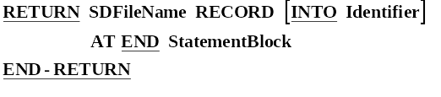
RELEASE and RETURN Syntax
Write
Read

Slide 20

Feeding the SORT from the keyboard.
8965125COUGHLAN
StudentFile
Sorted
Student
Records
SORT
Process
Unsorted
Student
Records
GetStudentDetails
WorkFile
SORT WorkFile ON ASCENDING KEY WStudentId
INPUT PROCEDURE IS GetStudentDetails
GIVING StudentFile.

Slide 21
ENVIRONMENT DIVISION.
INPUT-OUTPUT SECTION.
FILE-CONTROL.
SELECT StudentFile ASSIGN TO "SORTSTUD.DAT"
ORGANIZATION IS LINE SEQUENTIAL.
SELECT WorkFile ASSIGN TO "WORK.TMP".
DATA DIVISION.
FILE SECTION.
FD StudentFile.
01 StudentDetails PIC X(32).
SD WorkFile.
01 WorkRec.
02 WStudentId PIC 9(7).
02 FILLER PIC X(25).
PROCEDURE DIVISION.
Begin.
SORT WorkFile ON ASCENDING KEY WStudentId
INPUT PROCEDURE IS GetStudentDetails
GIVING StudentFile.
STOP RUN.
GetStudentDetails.
DISPLAY "Enter student details using template below."
DISPLAY "Enter no data to end.".
DISPLAY "NNNNNNNSSSSSSSSIIYYMMDDCCCCGGGGS".
ACCEPT WorkRec.
PERFORM UNTIL WorkRec = SPACES
RELEASE WorkRec
ACCEPT WorkRec
END-PERFORM.

Slide 22
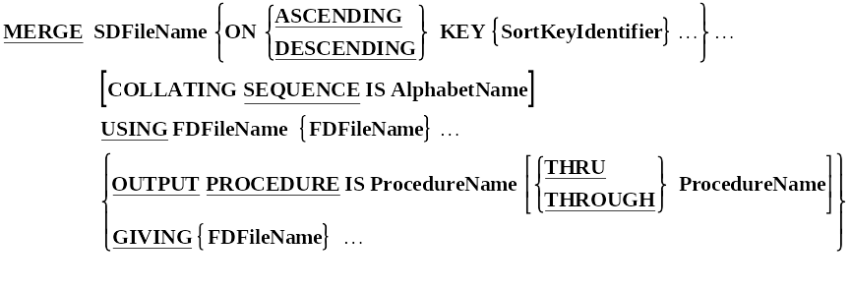
MERGE Syntax.
The Merge takes two or more identically sequenced files and combines them, according to the key values specified, to produce a combined file which is then output to an output file or OUTPUT PROCEDURE.
e.g.
MERGE WorkFile ON ASCENDING KEY StudentId
USING InsertionsFile, StudentFile
GIVING NewStudentFile.

Slide 23
ENVIRONMENT DIVISION.
INPUT-OUTPUT SECTION.
FILE-CONTROL.
SELECT StudentFile ASSIGN TO "STUDENTS.DAT"
ORGANIZATION IS LINE SEQUENTIAL.
SELECT InsertionsFile ASSIGN TO "TRANSINS.DAT"
ORGANIZATION IS LINE SEQUENTIAL.
SELECT NewStudentFile ASSIGN TO "STUDENTS.NEW"
ORGANIZATION IS LINE SEQUENTIAL.
SELECT WorkFile ASSIGN TO "WORK.TMP".
DATA DIVISION.
FILE SECTION.
FD StudentFile.
01 StudentRec PIC X(32).
FD InsertionsFile.
01 InsertionRec PIC X(32).
FD NewStudentFile.
01 NewStudentRec PIC X(32).
SD WorkFile.
01 WorkRec.
02 WStudentId PIC 9(7).
02 FILLER PIC X(25).
PROCEDURE DIVISION.
Begin.
MERGE WorkFile ON ASCENDING KEY WStudentId
USING InsertionsFile, StudentFile
GIVING NewStudentFile.
STOP RUN.

